Slide 1

NLP fundamentals

Slide 2
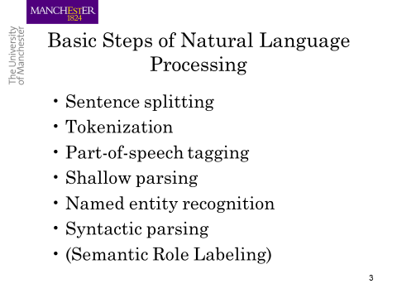

Slide 3
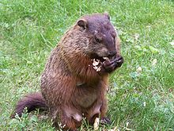
Regular expressions
A formal language for specifying text strings
How can we search for any of these?
woodchuck
woodchucks
Woodchuck
Woodchucks

Slide 4
Regular Expressions: Disjunctions
Letters inside square brackets []
Ranges [A-Z]
Pattern | Matches
[wW]oodchuck | Woodchuck, woodchuck
[1234567890] | Any digit
Pattern | Matches
[A-Z] | An upper case letter | Drenched Blossoms
[a-z] | A lower case letter | my beans were impatient
[0-9] | A single digit | Chapter 1: Down the Rabbit Hole

Slide 5
Regular Expressions: Negation in Disjunction
Negations [^Ss]
Carat means negation only when first in []
Pattern | Matches
[^A-Z] | Not an upper case letter | Oyfn pripetchik
[^Ss] | Neither ‘S’ nor ‘s’ | I have no exquisite reason”
[^e^] | Neither e nor ^ | Look here
a^b | The pattern a carat b | Look up a^b now

Slide 6
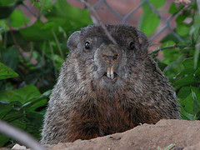
Regular Expressions: More Disjunction
Woodchucks is another name for groundhog!
The pipe | for disjunction
Pattern | Matches
groundhog|woodchuck
yours|mine | yours mine
a|b|c | = [abc]
[gG]roundhog|[Ww]oodchuck
Photo D. Fletcher

Slide 7
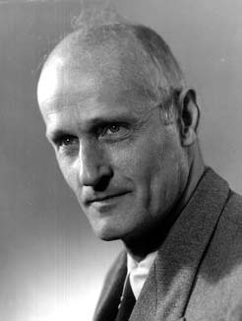
Regular Expressions: ? * + .
Pattern | Matches
colou?r | Optional previous char | color colour
oo*h! | 0 or more of previous char | oh! ooh! oooh! ooooh!
o+h! | 1 or more of previous char | oh! ooh! oooh! ooooh!
baa+ |  | baa baaa baaaa baaaaa
beg.n |  | begin begun begun beg3n
Stephen C Kleene
Kleene *, Kleene +

Slide 8
Regular Expressions: Anchors ^ $
Pattern | Matches
^[A-Z] | Palo Alto
^[^A-Za-z] | 1 “Hello”
\.$ | The end.
.$ | The end? The end!
^ – The caret anchor matches the beginning of the text.
$ – The dollar anchor matches the end of the text.
Find me all instances of the word “the” in a text.
the
Misses capitalized examples
[tT]he
Incorrectly returns other or theology
[^a-zA-Z][tT]he[^a-zA-Z]

Slide 9
Errors
The process we just went through was based on fixing two kinds of errors
Matching strings that we should not have matched (there, then, other)
False positives (Type I)
Not matching things that we should have matched (The)
False negatives (Type II)

Slide 10
Errors cont.
In NLP we are always dealing with these kinds of errors.
Reducing the error rate for an application often involves two antagonistic efforts:
Increasing accuracy or precision (minimizing false positives)
Increasing coverage or recall (minimizing false negatives).

Slide 11
Summary
Regular expressions play a surprisingly large role
Sophisticated sequences of regular expressions are often the first model for any text processing
For many hard tasks, we use machine learning classifiers
But regular expressions can be used as features in the classifiers
Can be very useful in capturing generalizations

Slide 12
Word tokenization

Slide 13
Text Normalization
Most NLP tasks need to do text normalization:
Segmenting/tokenizing words in running text
Normalizing word formats
Segmenting sentences in running text

Slide 14
How many words?
I do uh main- mainly business data processing
Fragments, filled pauses
Seuss’s cat in the hat is different from other cats!
Lemma: same stem, part of speech, rough word sense
cat and cats = same lemma
Wordform: the full inflected surface form
cat and cats = different wordforms

Slide 15
How many words?
they lay back on the San Francisco grass and looked at the stars and their
Type: an element of the vocabulary.
Token: an instance of that type in running text.
How many?
15 tokens …………(or 14)?
13 types …………..(or 12)?

Slide 16
How many words?
N = number of tokens
V = vocabulary = set of types
|V| is the size of the vocabulary
https://books.google.com/ngrams/
Switchboard is a collection of about 2,400 two-sided telephone conversations among 543 speakers (302 male, 241 female) from all areas of the United States.
 | Tokens = N | Types = |V|
Switchboard phone conversations | 2.4 million | 20 thousand
Shakespeare | 884,000 | 31 thousand
Google N-grams | 1 trillion | 13 million

Slide 17
Simple Tokenization in UNIX
(Inspired by Ken Church’s UNIX for Poets.)
Given a text file, output the word tokens and their frequencies
tr -sc "A-Za-z" "\n" < sample.txt
| sort
| uniq –c
1945 A
72 AARON
19 ABBESS
5 ABBOT
... ...
Change all non-alpha to newlines
Sort in alphabetical order
Merge and count each type
25 Aaron
6 Abate
1 Abates
5 Abbess
6 Abbey
3 Abbot
.... …

Slide 18
The first step: tokenizing
tr -sc "A-Za-z" "\n" < sample.txt | head
THE
SONNETS
by
William
Shakespeare
From
fairest
creatures
We
...

Slide 19
The second step: sorting
tr -sc "A-Za-z" "\n" < sample.txt | sort | head
A
A
A
A
A
A
A
A
A
...

Slide 20
More counting
Merging upper and lower case
tr "A-Z" "a-z" < sample.txt | tr -sc "A-Za-z" "\n" | sort | uniq –c
Sorting the counts
tr "A-Z" "a-z" < sample.txt | tr -sc "A-Za-z" "\n" | sort | uniq -c | sort -n -r
23243 the
22225 i
18618 and
16339 to
15687 of
12780 a
12163 you
10839 my
10005 in
8954 d
What happened here?

Slide 21
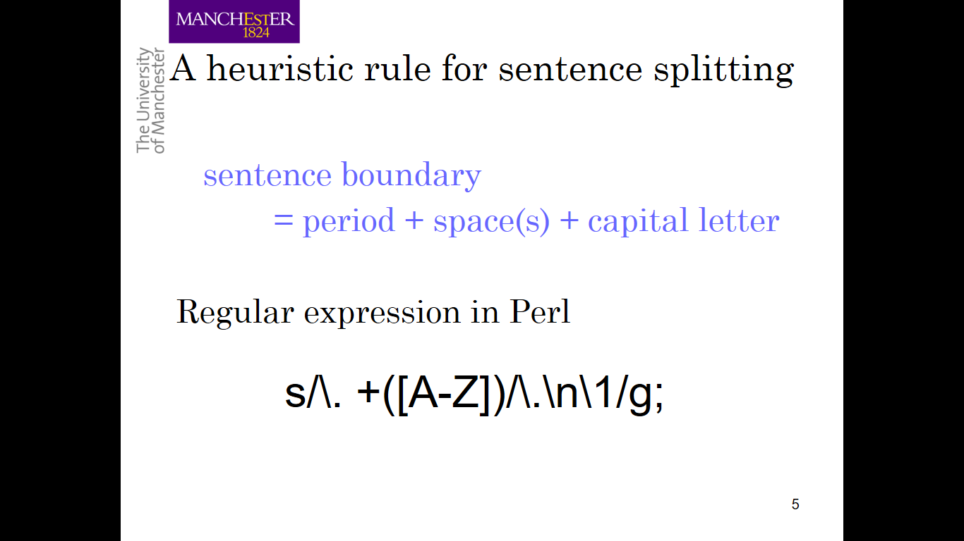

Slide 22
Issues in Tokenization
Finland’s capital → Finland Finlands Finland’s ?
what’re, I’m, isn’t → What are, I am, is not
Hewlett-Packard → Hewlett Packard ?
state-of-the-art → state of the art ?
Lowercase → lower-case lowercase lower case ?
San Francisco → one token or two?
m.p.h., PhD. → ??

Slide 23
Tokenization: language issues
French
L'ensemble → one token or two?
L ? L’ ? Le ?
Want l’ensemble to match with un ensemble
German noun compounds are not segmented
Lebensversicherungsgesellschaftsangestellter
‘life insurance company employee’
German information retrieval needs compound splitter

Slide 24
Tokenization: language issues
Chinese and Japanese no spaces between words:
莎拉波娃现在居住在美国东南部的佛罗里达。
莎拉波娃 现在 居住 在 美国 东南部 的 佛罗里达
Sharapova now lives in US southeastern Florida
Further complicated in Japanese, with multiple alphabets intermingled
Dates/amounts in multiple formats
フォーチュン500社は情報不足のため時間あた$500K(約6,000万円)
Katakana
Hiragana
Kanji
Romaji
End-user can express query entirely in hiragana!

Slide 25
Word Normalization and Stemming

Slide 26
Normalization
Need to “normalize” terms
Information Retrieval: indexed text & query terms must have same form.
We want to match U.S.A. and USA
We implicitly define equivalence classes of terms
e.g., deleting periods in a term
Alternative: asymmetric expansion:
Enter: window Search: window, windows
Enter: windows Search: Windows, windows, window
Enter: Windows Search: Windows
Potentially more powerful, but less efficient

Slide 27
Case folding
Applications like IR: reduce all letters to lower case
Since users tend to use lower case
Possible exception: upper case in mid-sentence?
e.g., General Motors
Fed vs. fed
SAIL vs. sail
For sentiment analysis, MT, Information extraction
Case is helpful (US versus us is important)

Slide 28
Lemmatization
Reduce inflections or variant forms to base form
am, are, is → be
car, cars, car's, cars' → car
the boy's cars are different colors → the boy car be different color
Lemmatization: have to find correct dictionary headword form
Machine translation
Spanish quiero (‘I want’), quieres (‘you want’) same lemma as querer ‘want’

Slide 29
Morphology
Morphemes:
The small meaningful units that make up words
Stems: The core meaning-bearing units
Affixes: Bits and pieces that adhere to stems
Often with grammatical functions

Slide 30
Stemming
Reduce terms to their stems in information retrieval
Stemming is crude chopping of affixes
language dependent
e.g., automate(s), automatic, automation all reduced to automat.
for example compressed
and compression are both
accepted as equivalent to
compress.
for exampl compress and
compress ar both accept
as equival to compress

Slide 31
Porter’s algorithm The most common English stemmer
Step 1a
sses → ss caresses → caress
ies → i ponies → poni
ss → ss caress → caress
s → ø cats → cat
Step 1b
(*v*)ing → ø walking → walk
sing → sing
(*v*)ed → ø plastered → plaster
…
Step 2 (for long stems)
ational→ ate relational→ relate
izer→ ize digitizer → digitize
ator→ ate operator → operate
…
Step 3 (for longer stems)
al → ø revival → reviv
able → ø adjustable → adjust
ate → ø activate → activ
…

Slide 32
Viewing morphology in a corpus Why only strip –ing if there is a vowel?
(*v*)ing → ø walking → walk
sing → sing

Slide 33
Viewing morphology in a corpus Why only strip –ing if there is a vowel?
(*v*)ing → ø walking → walk
sing → sing
tr -sc "A-Za-z" "\n" < sample.txt | grep "ing$" | sort | uniq -c | sort –nr
tr -sc "A-Za-z" "\n" < sample.txt | grep "[aeiou].*ing$" | sort | uniq -c | sort –nr
1312 King
548 being
541 nothing
388 king
375 bring
358 thing
307 ring
152 something
145 coming
130 morning
548 being
541 nothing
152 something
145 coming
130 morning
122 having
120 living
117 loving
116 Being
102 going

Slide 34
Dealing with complex morphology is sometimes necessary
Some languages require complex morpheme segmentation
Turkish
Uygarlastiramadiklarimizdanmissinizcasina
`(behaving) as if you are among those whom we could not civilize’
Uygar `civilized’ + las `become’
+ tir `cause’ + ama `not able’
+ dik `past’ + lar ‘plural’
+ imiz ‘p1pl’ + dan ‘abl’
+ mis ‘past’ + siniz ‘2pl’ + casina ‘as if’

Slide 35
Sentence Segmentation and Decision Trees

Slide 36
Sentence Segmentation
!, ? are relatively unambiguous
Period “.” is quite ambiguous
Sentence boundary
Abbreviations like Inc. or Dr.
Numbers like .02% or 4.3
Build a binary classifier
Looks at a “.”
Decides EndOfSentence/NotEndOfSentence
Classifiers: hand-written rules, regular expressions, or machine-learning

Slide 37
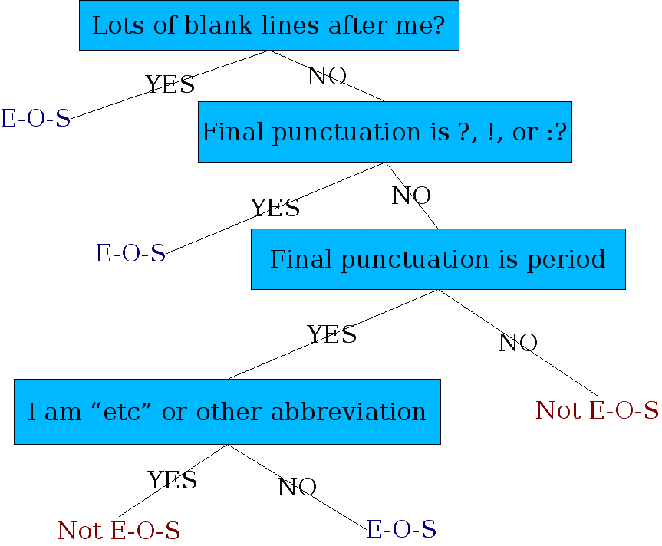
Determining if a word is end-of-sentence: a Decision Tree

Slide 38
More sophisticated decision tree features
Case of word with “.”: Upper, Lower, Cap, Number
Case of word after “.”: Upper, Lower, Cap, Number
Numeric features
Length of word with “.”
Probability(word with “.” occurs at end-of-s)
Probability(word after “.” occurs at beginning-of-s)

Slide 39
Implementing Decision Trees
A decision tree is just an if-then-else statement
The interesting research is choosing the features
Setting up the structure is often too hard to do by hand
Hand-building only possible for very simple features, domains
For numeric features, it’s too hard to pick each threshold
Instead, structure usually learned by machine learning from a training corpus

Slide 40
Decision Trees and other classifiers
We can think of the questions in a decision tree
as features that could be exploited by any kind of classifier:
Logistic regression
SVM
Neural Nets
etc.

Slide 41
Part-of-speech (POS) tagging

Slide 42
Open class (lexical) words
Nouns
Verbs
Adjectives
old older oldest
Proper
Common
Main
Adverbs
slowly
IBM
Italy
cat / cats
snow
see
registered
Numerals
… more
122,312
one fifth
Closed class (functional)
Modals
Determiners
the some
can
had
Prepositions
to with
Conjunctions
and or
Particles
off up
… more
Pronouns
he its
Interjections
Ow Eh

Slide 43
POS Tagging
Words often have more than one POS: back
The back door = JJ
On my back = NN
Win the voters back = RB
Promised to back the bill = VB
The POS tagging problem is to determine the POS tag for a particular instance of a word.

Slide 44
POS Tagging
Input: Plays well with others
Ambiguity: NNS/VBZ UH/JJ/NN/RB IN NNS
Output: Plays/VBZ well/RB with/IN others/NNS
Uses:
Text-to-speech (how do we pronounce “lead”?)
Can write regexps like (Det) Adj* N+ over the output for phrases, etc.
As input to or to speed up a full parser
If you know the tag, you can back off to it in other tasks
Penn Treebank POS tags

Slide 45
POS tagging performance
How many tags are correct? (Tag accuracy)
About 97% currently
But baseline is already 90%
Baseline is performance of stupidest possible method
Tag every word with its most frequent tag
Tag unknown words as nouns
Partly easy because
Many words are unambiguous
You get points for them (the, a, etc.) and for punctuation marks!

Slide 46
Deciding on the correct part of speech can be difficult even for people
Mrs/NNP Shaefer/NNP never/RB got/VBD around/RP to/TO joining/VBG
All/DT we/PRP gotta/VBN do/VB is/VBZ go/VB around/IN the/DT corner/NN
Chateau/NNP Petrus/NNP costs/VBZ around/RB 250/CD

Slide 47
How difficult is POS tagging?
About 11% of the word types in the Brown corpus are ambiguous with regard to part of speech
But they tend to be very common words. E.g., that
I know that he is honest = IN
Yes, that play was nice = DT
You can’t go that far = RB
40% of the word tokens are ambiguous

Slide 48
Sources of information
What are the main sources of information for POS tagging?
Knowledge of neighboring words
Bill saw that man yesterday
NNP NN DT NN NN
VB VB(D) IN VB NN
Knowledge of word probabilities
man is rarely used as a verb….
The latter proves the most useful, but the former also helps
Notes:
These were the features of HMM taggers

Slide 49
More and Better Features 🡺 Feature-based tagger
Can do surprisingly well just looking at a word by itself:
Word the: the → DT
Lowercased word Importantly: importantly → RB
Prefixes unfathomable: un- → JJ
Suffixes Importantly: -ly → RB
Capitalization Meridian: CAP → NNP
Word shapes 35-year: d-x → JJ
Then build a maxent (or whatever) model to predict tag
Maxent P(t|w): 93.7% overall / 82.6% unknown
Notes:
Doing better

Slide 50
Use of POS tags in downstream NLP tasks
Features in text classifiers (e.g. spam / not spam)
Noun-phrase chunking
United Nations
NNP NNP

Slide 51
POS taggers
Stanford POS tagger
https://nlp.stanford.edu/software/tagger.shtml
Natural Language Tool Kit (NLTK)
https://www.nltk.org
Illinois POS tagger
http://cogcomp.org/page/software_view/POS

Slide 52
Syntactic parsing

Slide 53
Two views of linguistic structure
1. Constituency (phrase structure)
2. Dependency structure

Slide 54
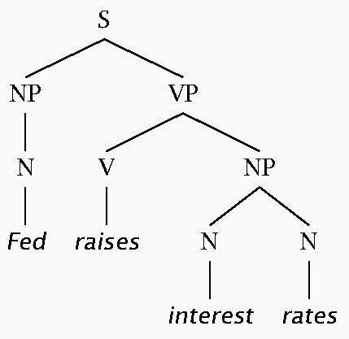
Two views of linguistic structure: 1. Constituency (phrase structure)
Phrase structure organizes words into nested constituents.
How do we know what is a constituent? (Not that linguists don’t argue about some cases.)
Distribution: a constituent behaves as a unit that can appear in different places:
John talked [to the children] [about drugs].
John talked [about drugs] [to the children].
*John talked drugs to the children about
Substitution/expansion/pro-forms:
I sat [on the box/right on top of the box/there].
Coordination, regular internal structure, no intrusion,
fragments, semantics, …

Slide 55
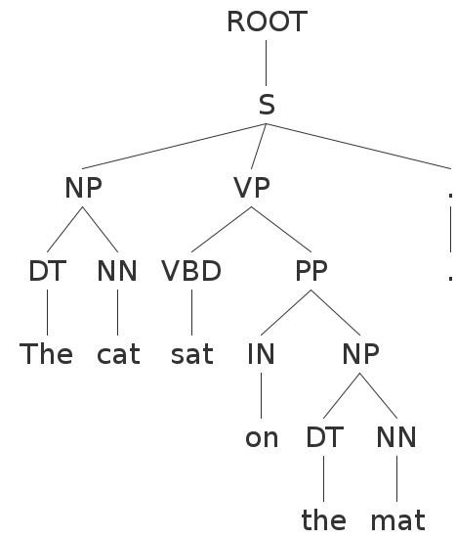
Parse Trees
“The cat sat on the mat”

Slide 56
Parse Trees
In bracket notation:
(ROOT
(S
(NP (DT the) (NN cat))
(VP (VBD sat)
(PP (IN on)
(NP (DT the) (NN mat))))))

Slide 57
Grammars
There are typically multiple ways to produce the same sentence. Consider the statement by Groucho Marx:
“While I was in Africa, I shot an elephant in my pajamas”
“How he got into my pajamas, I don’t know”

Slide 58
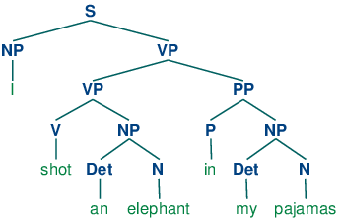
Parse Trees
“…,I shot an elephant in my pajamas” -what people hear first

Slide 59
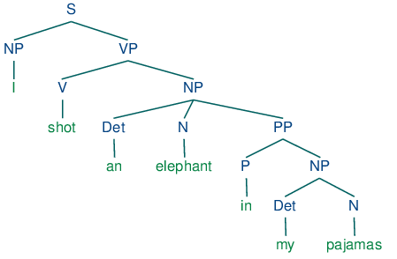
Parse Trees
Groucho’s version

Slide 60
Grammars
Its also possible to have “sentences” inside other sentences…
S 🡪 NP VP
VP 🡪 VB NP SBAR
SBAR 🡪 IN S

Slide 61
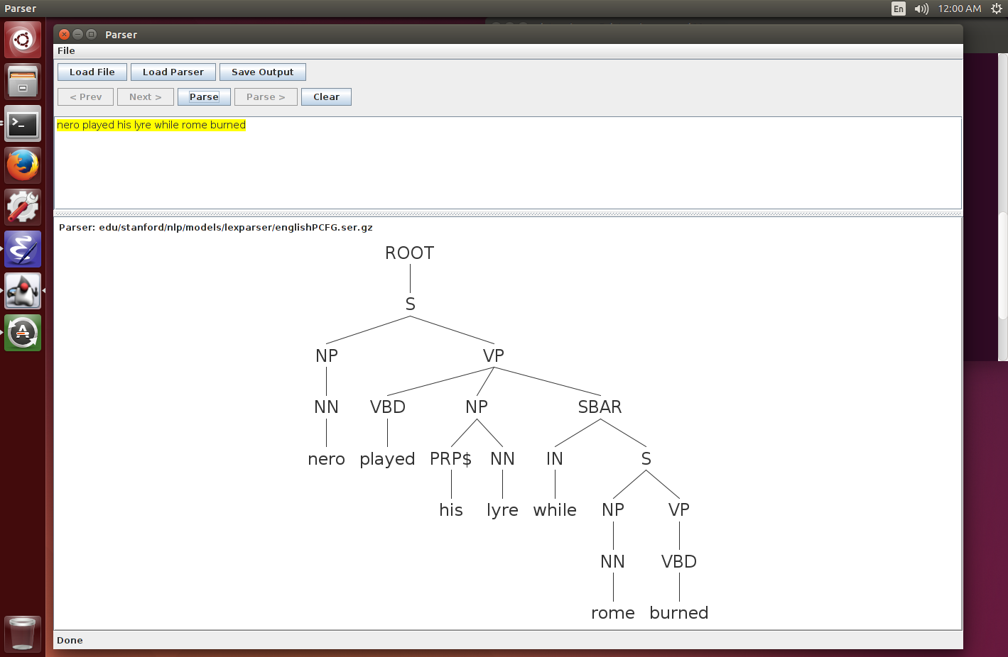
Recursion in Grammars
“Nero played his lyre while Rome burned”.

Slide 62
Headed phrase structure
VP → … VB* …
NP → … NN* …
ADJP → … JJ* …
ADVP → … RB* …
SBAR(Q) → S|SINV|SQ → … NP VP …
Plus minor phrase types:
QP (quantifier phrase in NP), CONJP (multi word constructions: as well as), INTJ (interjections), etc.

Slide 63
PCFGs
Complex sentences can be parsed in many ways, most of which make no sense or are extremely improbable (like Groucho’s example).
Probabilistic Context-Free Grammars (PCFGs) associate and learn probabilities for each rule:
S 🡪 NP VP 0.8
S 🡪 NP VP PP 0.2
The parser then tries to find the most likely sequence of productions that generate the given sentence. This adds more realistic “world knowledge” and generally gives much better results.
Most state-of-the-art parsers these days use PCFGs.

Slide 64
Systems
NLTK: Python-based NLP system. Many modules, good visualization tools, but not quite state-of-the-art performance.
Stanford Parser: Another comprehensive suite of tools (also POS tagger), and state-of-the-art accuracy. Has the definitive dependency module.
Berkeley Parser: Slightly higher parsing accuracy (than Stanford) but not as many modules.
Note: high-quality dependency parsing is usually very slow, but see: https://github.com/dlwh/puck

Slide 65
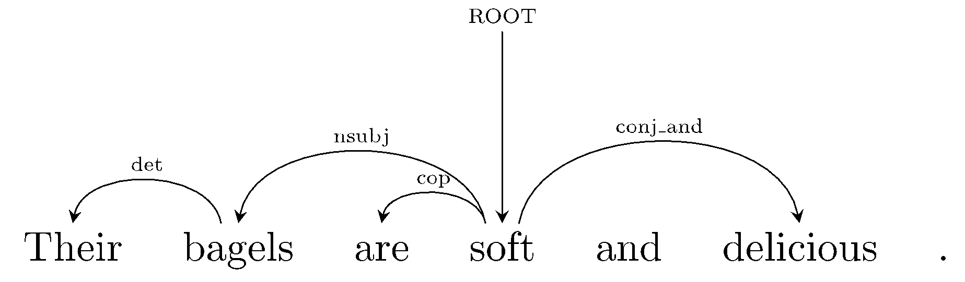
Two views of linguistic structure: 2. Dependency structure
Dependency structure shows which words depend on (modify or are arguments of) which other words.

Slide 66
“Their bagels are soft and delicious.”
root ( ROOT-0 , soft-4 )
nmod:poss ( bagels-2 , Their-1 )
nsubj ( soft-4 , bagels-2 )
nsubj ( delicious-6 , bagels-2 )
cop ( soft-4 , are-3 )
cc ( soft-4 , and-5 )
conj:and ( soft-4 , delicious-6 )
Typed dependency (relationship) between two words: head and modifier. Also known as governor and dependent.

Slide 67
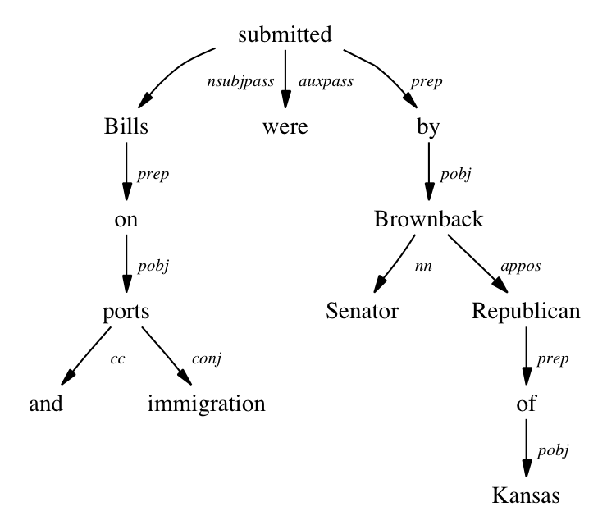
Dependency Parsing
Dependency parses may be non-binary, and structure type is encoded in links rather than nodes:

Slide 68
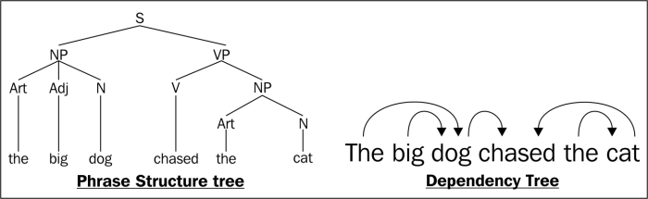
Comparison between constituent (phrase) and dependency trees

Slide 69
Dependency parser
Stanford dependency parser
https://nlp.stanford.edu/software/stanford-dependencies.shtml

Slide 70
Statistical parsing applications
Statistical parsers are now robust and widely used in larger NLP applications:
High precision question answering [Pasca and Harabagiu SIGIR 2001]
Improving biological named entity finding [Finkel et al. JNLPBA 2004]
Syntactically based sentence compression [Lin and Wilbur 2007]
Extracting opinions about products [Bloom et al. NAACL 2007]
Improved interaction in computer games [Gorniak and Roy 2005]
Helping linguists find data [Resnik et al. BLS 2005]
Source sentence analysis for machine translation [Xu et al. 2009]
Relation extraction systems [Fundel et al. Bioinformatics 2006]

Slide 71
Credits
Some slides have been adapted from:
https://web.stanford.edu/~jurafsky/NLPCourseraSlides.html

